Slide 1

OT LABORATEGI BIRTUALAK
5. PLC Sare birtuala
(3 Tia Portal+PLCSIM+NetTOPLC + 3 Codesys > Keepserver > Factory)
Notes:
n

Slide 2
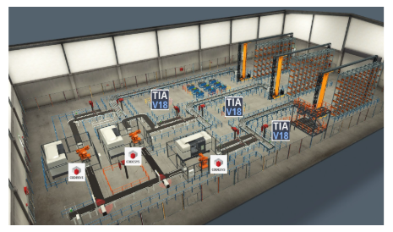
5. PLC Sare birtuala (3 Tia Portal+PLCSIM+NetTOPLC + 3 Codesys > Keepserver > Factory)

Slide 3
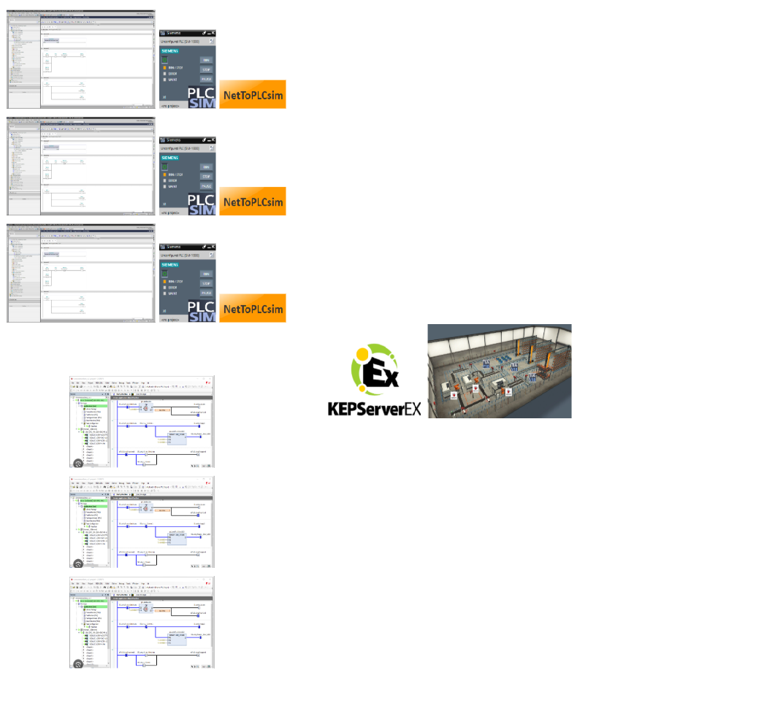
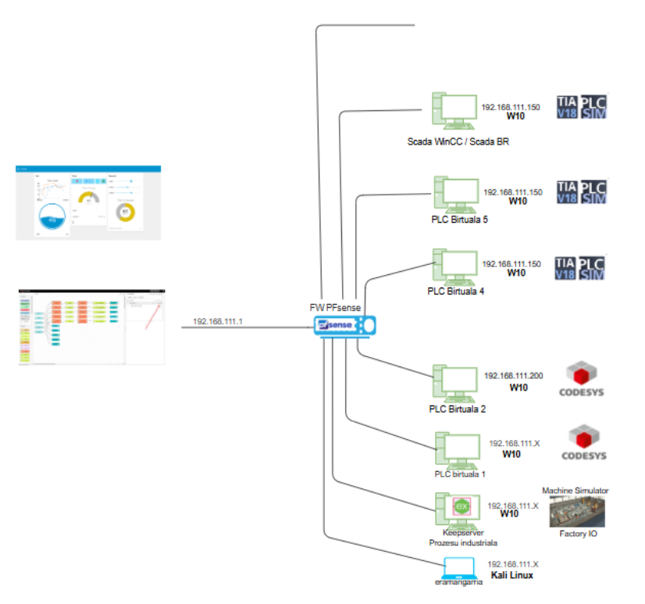
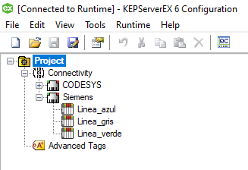

5. PLC Sare birtuala (3 Tia Portal+PLCSIM+NetTOPLC + 3 Codesys > Keepserver > Factory)

Slide 4
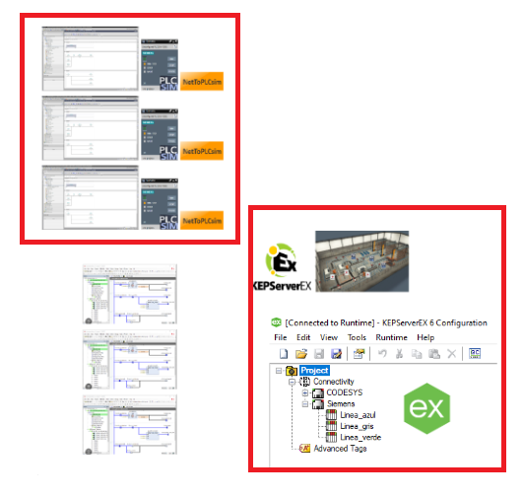
5. PLC Sare birtuala (3 Tia Portal+PLCSIM+NetTOPLC + 3 Codesys > Keepserver > Factory)

Slide 5


5. PLC Sare birtuala (3 Tia Portal+PLCSIM+NetTOPLC + 3 Codesys > Keepserver > Factory)

Slide 6
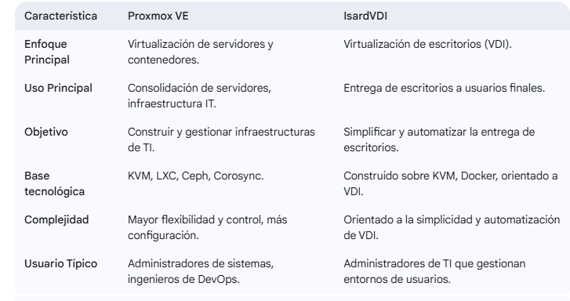
5. PLC Sare birtuala (3 Tia Portal+PLCSIM+NetTOPLC + 3 Codesys > Keepserver > Factory)

Slide 7

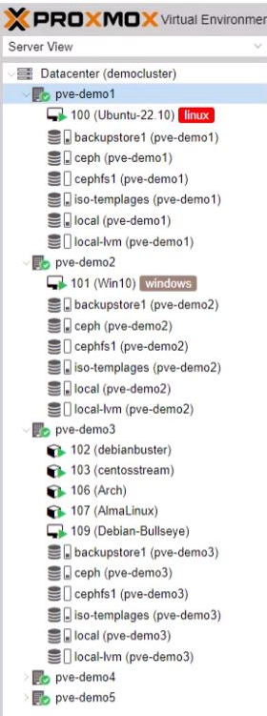
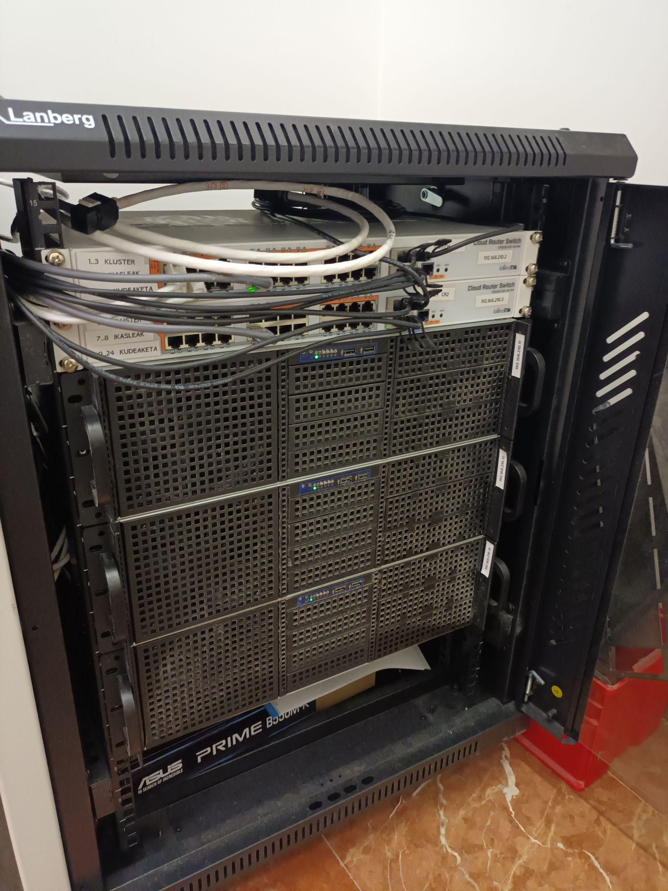
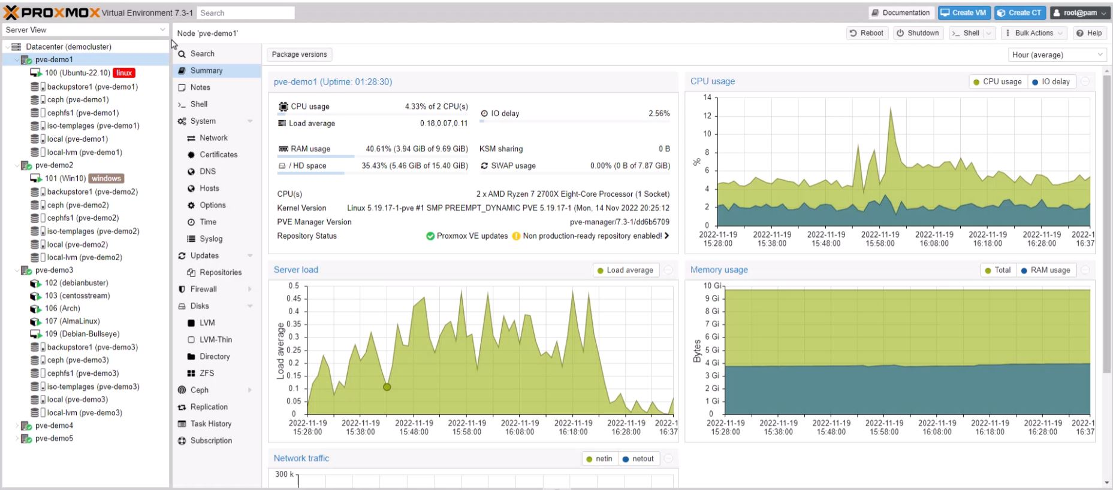
5. PLC Sare birtuala (3 Tia Portal+PLCSIM+NetTOPLC + 3 Codesys > Keepserver > Factory)

Slide 8
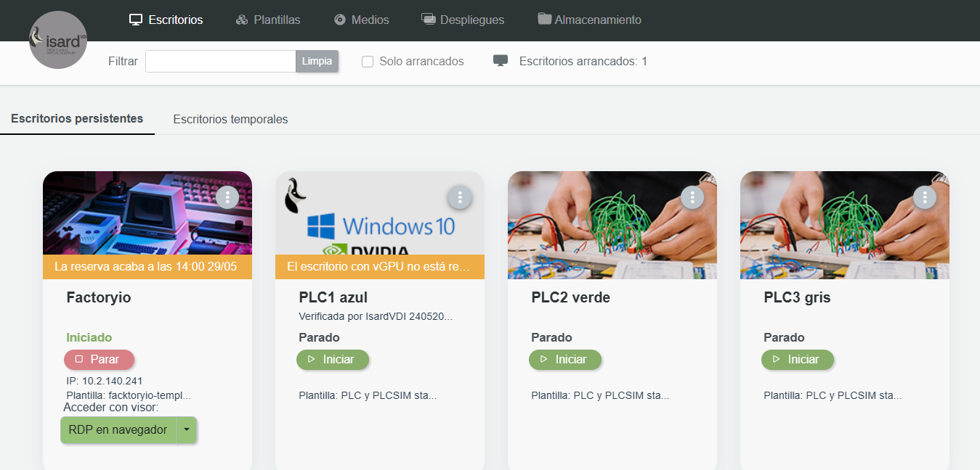
5. PLC Sare birtuala (3 Tia Portal+PLCSIM+NetTOPLC + 3 Codesys > Keepserver > Factory)
Factory , Kepserver
Producción azul
Producción verde
Producción gris

Slide 9
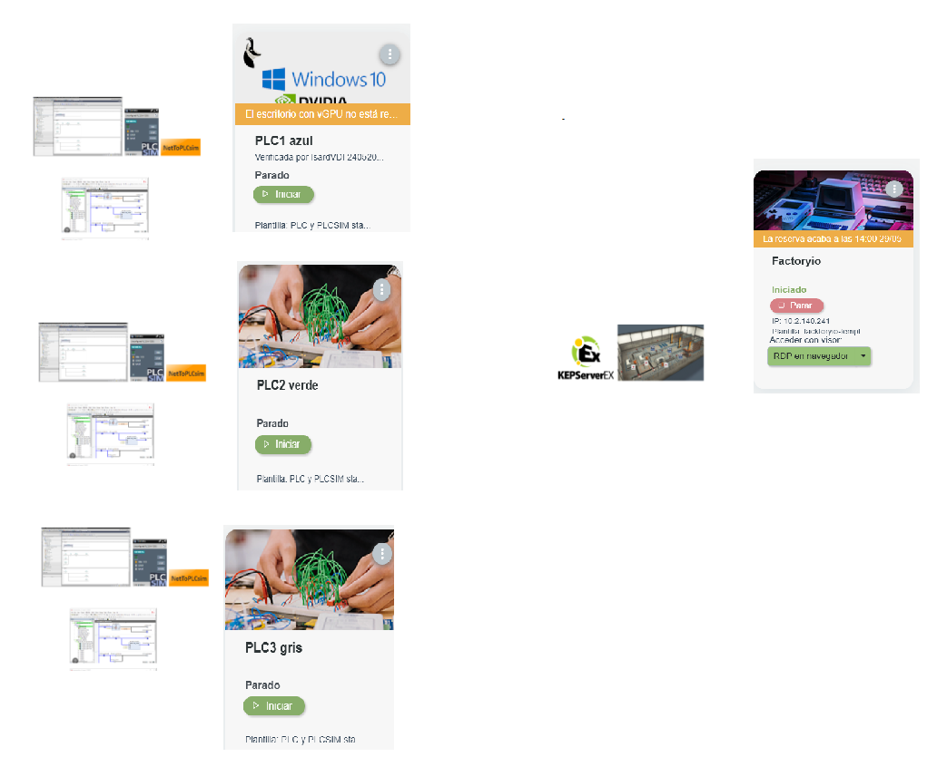
5. PLC Sare birtuala (3 Tia Portal+PLCSIM+NetTOPLC + 3 Codesys > Keepserver > Factory)

Slide 10
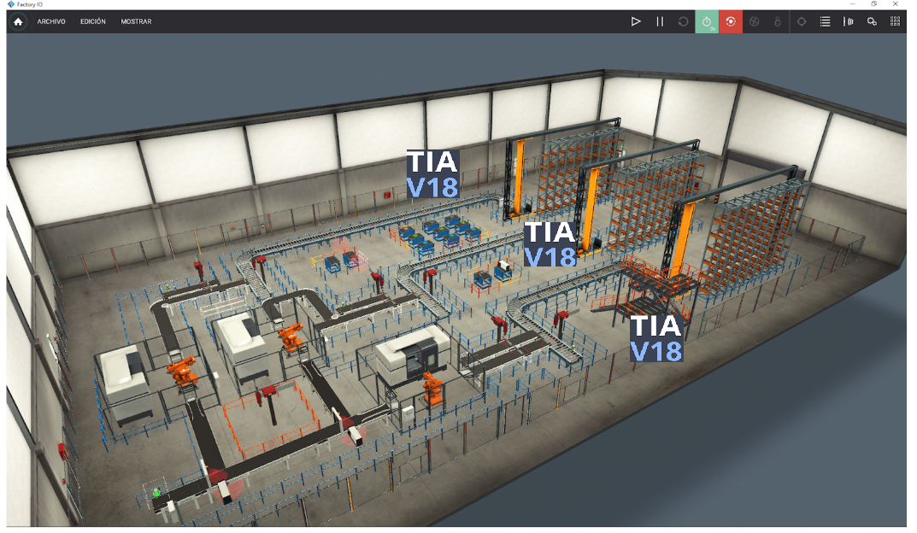
5. PLC Sare birtuala (3 Tia Portal+PLCSIM+NetTOPLC + 3 Codesys > Keepserver > Factory)

Slide 11

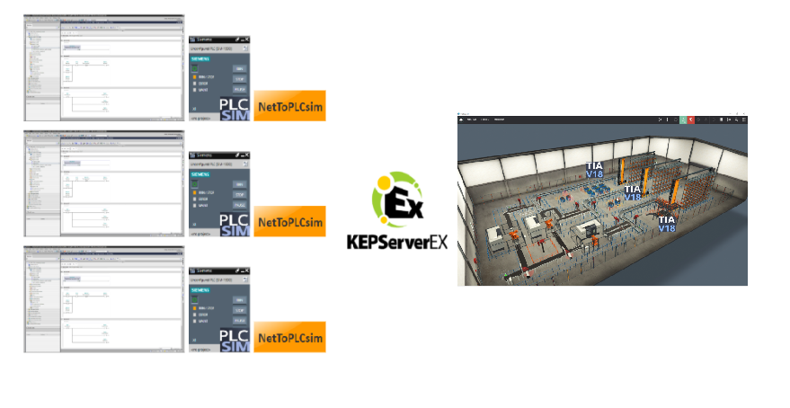
5. PLC Sare birtuala (3 Tia Portal+PLCSIM+NetTOPLC + 3 Codesys > Keepserver > Factory)
10.15.181.23
Eth/Wifi
Producción Azul
10.15.18130
10.15.181.24
Producción Verde
10.15.181.25
Producción Gris
Tia Portal proiektuak
Kepserver fitxategia
Factory eszena

Slide 12
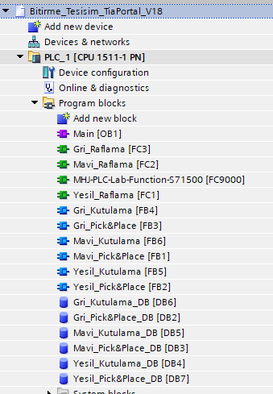
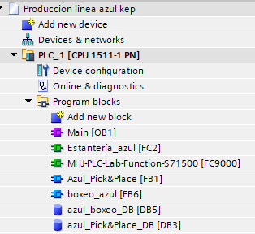
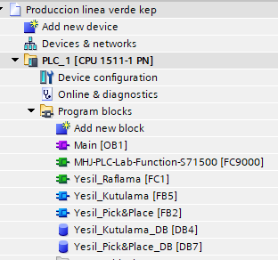
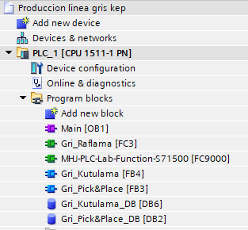

5. PLC Sare birtuala (3 Tia Portal+PLCSIM+NetTOPLC + 3 Codesys > Keepserver > Factory)
Jatorrizko proiektua
Producción Azul
Producción Verde
Producción Gris

Slide 13
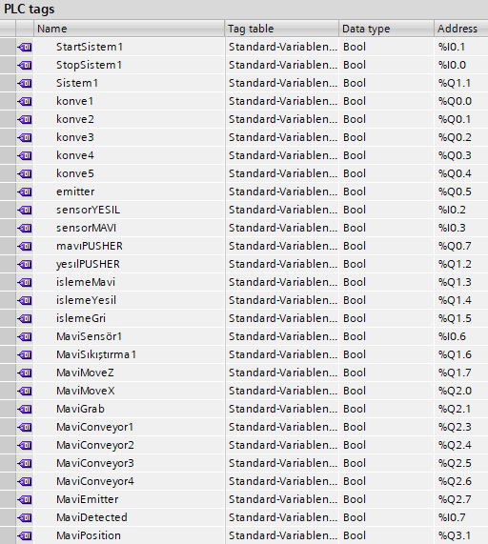
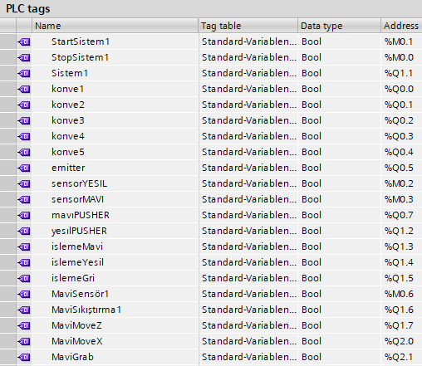
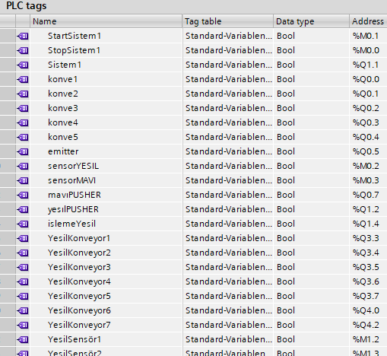
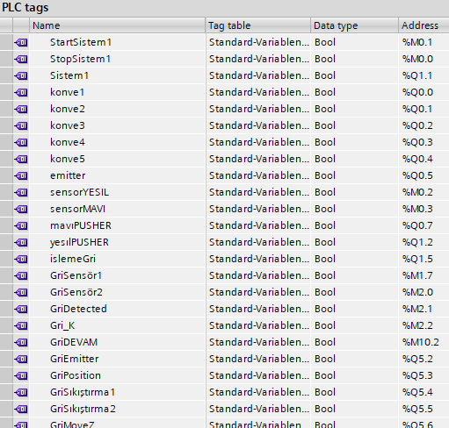
5. PLC Sare birtuala (3 Tia Portal+PLCSIM+NetTOPLC + 3 Codesys > Keepserver > Factory)
Jatorrizko proiektua
Producción Azul
Producción Verde
Producción Gris

Slide 14
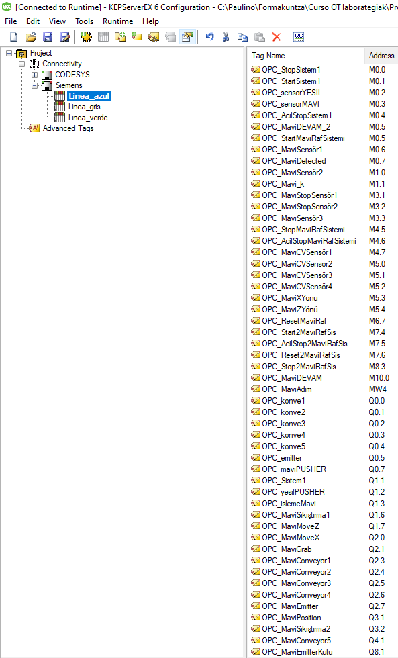
5. PLC Sare birtuala (3 Tia Portal+PLCSIM+NetTOPLC + 3 Codesys > Keepserver > Factory)

Slide 15
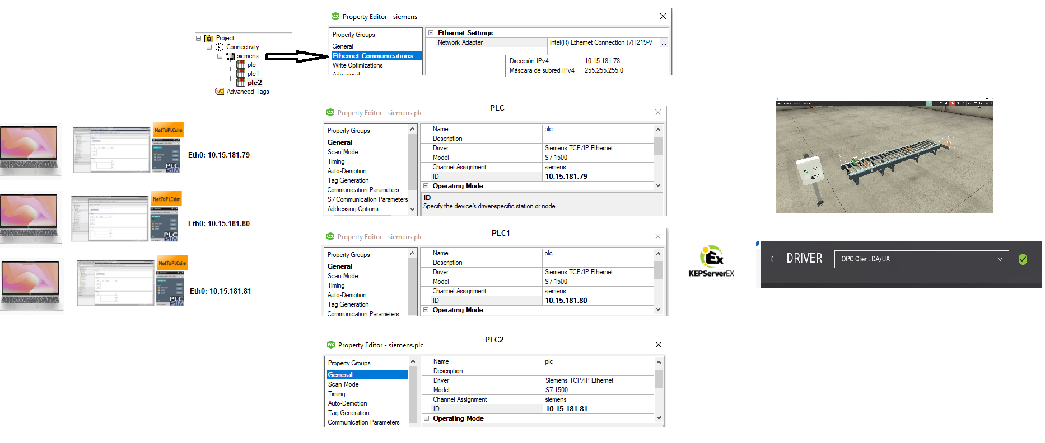
5. PLC Sare birtuala (3 Tia Portal+PLCSIM+NetTOPLC + 3 Codesys > Keepserver > Factory)

Slide 16
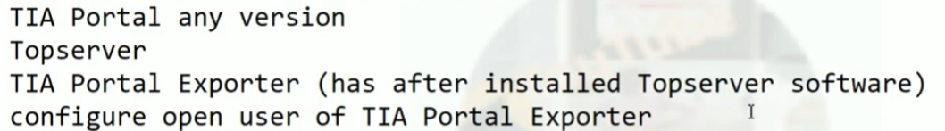
5. PLC Sare birtuala (3 Tia Portal+PLCSIM+NetTOPLC + 3 Codesys > Keepserver > Factory)
Export all tags from TIA portal to Kepware by using TIA Portal Exporter and Topserver
https://www.youtube.com/watch?v=vLYjEtCXR6M

Slide 17
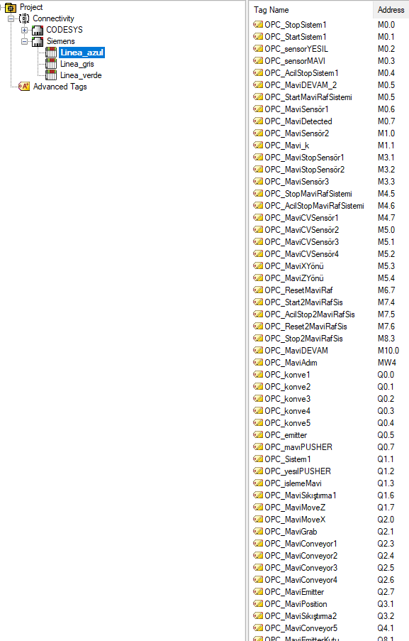
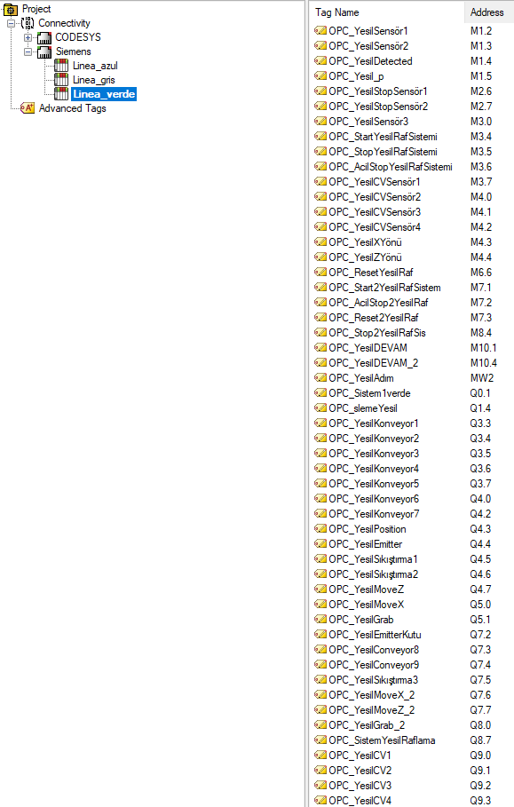
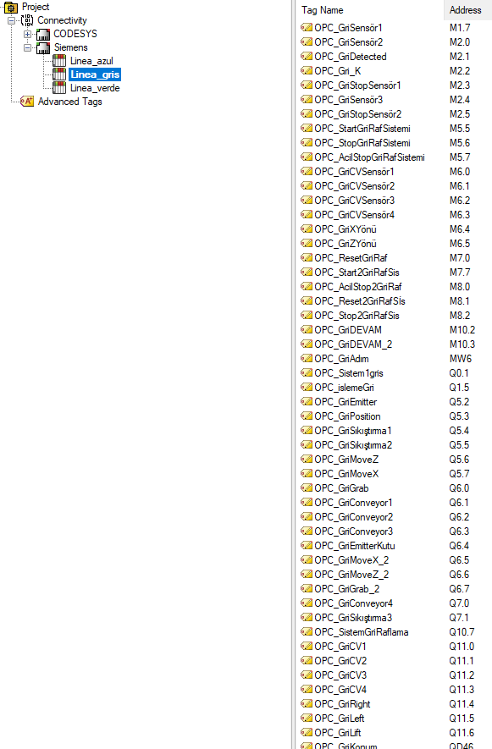
5. PLC Sare birtuala (3 Tia Portal+PLCSIM+NetTOPLC + 3 Codesys > Keepserver > Factory)

Slide 18
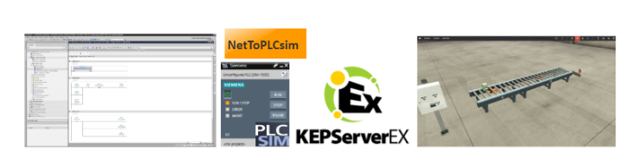
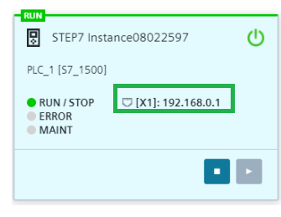
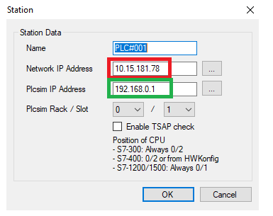
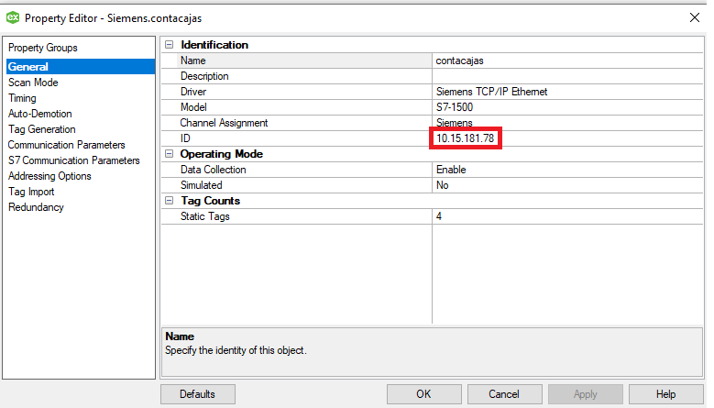



4.-PLC Siemens Birtuala
(Tia Portal+PLCSIM+NetTOPLC > Keepserver > Factory)

Slide 19
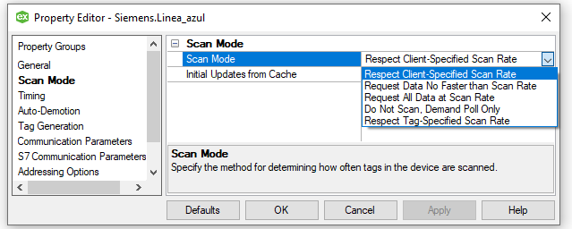
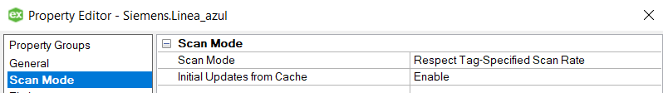
5. PLC Sare birtuala (3 Tia Portal+PLCSIM+NetTOPLC + 3 Codesys > Keepserver > Factory)
PLC
Scan mode:
“Optimizatu”

Slide 20
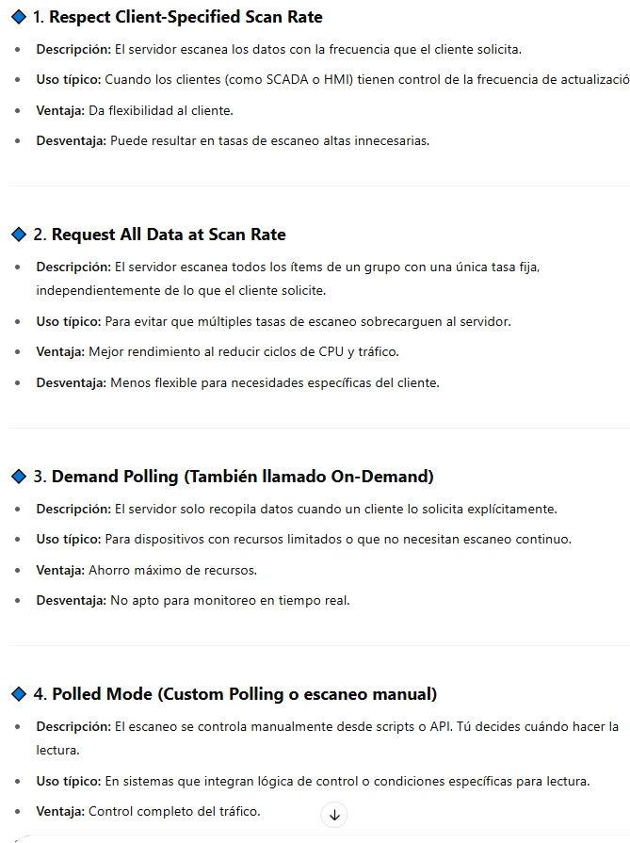
5. PLC Sare birtuala (3 Tia Portal+PLCSIM+NetTOPLC + 3 Codesys > Keepserver > Factory)
En KEPServerEX, el scan mode (modo de escaneo) determina cómo y cuándo el servidor recopila datos desde los dispositivos conectados. Esto es fundamental para optimizar el rendimiento, la latencia y el tráfico de red.
Las diferentes maneras de configurar el scan mode en KEPServerEX son:

Slide 21
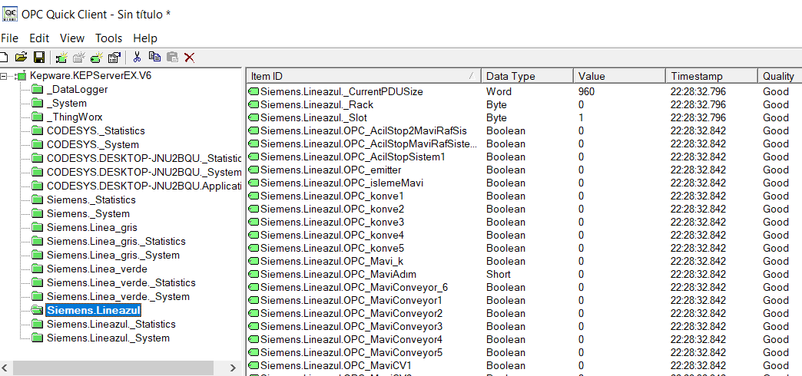
5. PLC Sare birtuala (3 Tia Portal+PLCSIM+NetTOPLC + 3 Codesys > Keepserver > Factory)

Slide 22
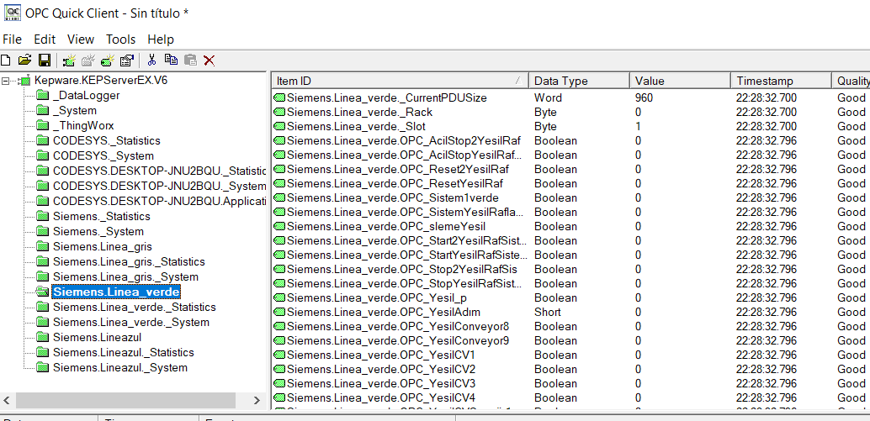
5. PLC Sare birtuala (3 Tia Portal+PLCSIM+NetTOPLC + 3 Codesys > Keepserver > Factory)

Slide 23
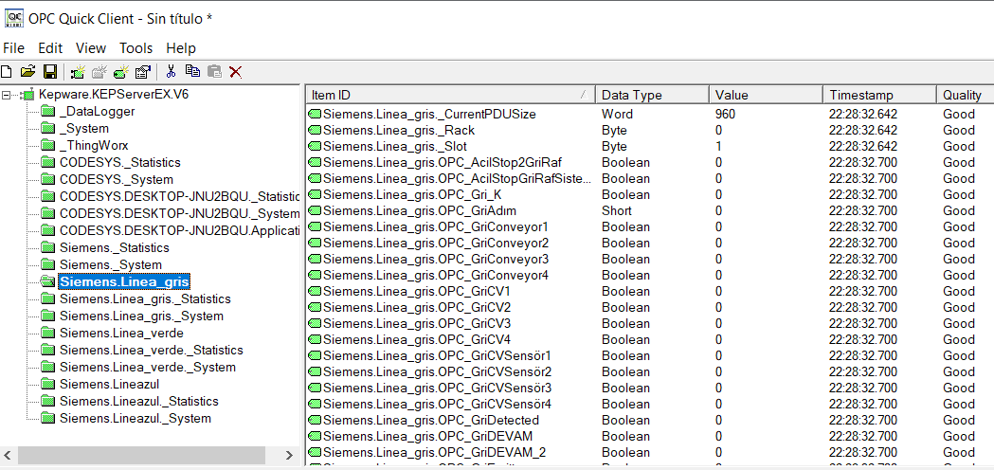
5. PLC Sare birtuala (3 Tia Portal+PLCSIM+NetTOPLC + 3 Codesys > Keepserver > Factory)

Slide 24
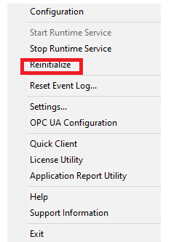
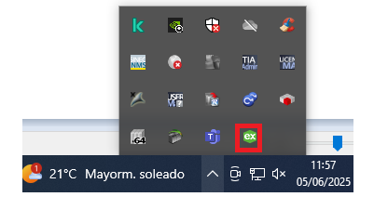
5. PLC Sare birtuala (3 Tia Portal+PLCSIM+NetTOPLC + 3 Codesys > Keepserver > Factory)
Kepserver mugatua (+- 3 ordu; Berrabiarazi)

Slide 25
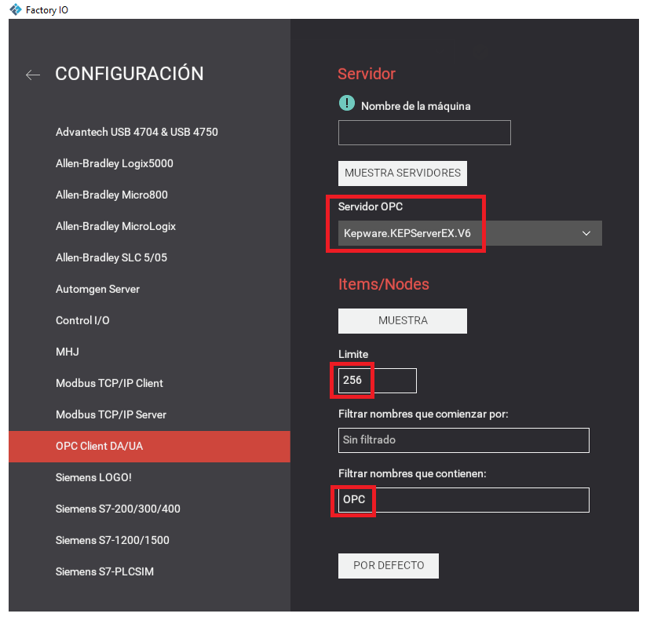
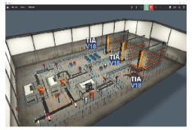
5. PLC Sare birtuala (3 Tia Portal+PLCSIM+NetTOPLC + 3 Codesys > Keepserver > Factory)

Slide 26
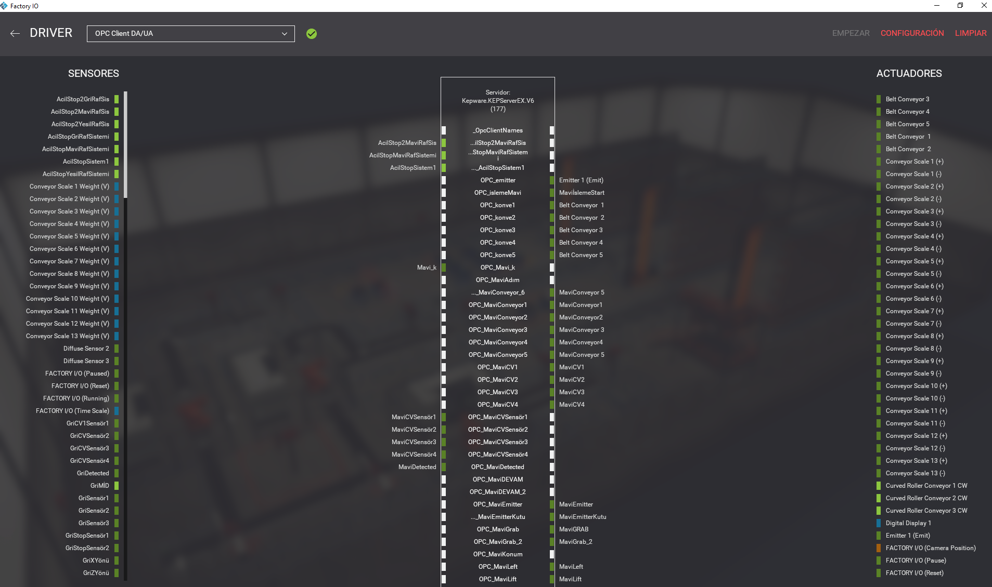
5. PLC Sare birtuala (3 Tia Portal+PLCSIM+NetTOPLC + 3 Codesys > Keepserver > Factory)

Slide 27
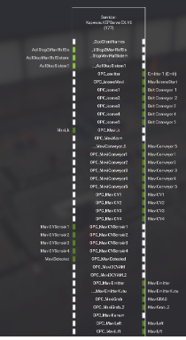
5. PLC Sare birtuala (3 Tia Portal+PLCSIM+NetTOPLC + 3 Codesys > Keepserver > Factory)
Aldagaien
ibilbidea

Slide 28
5. PLC Sare birtuala (3 Tia Portal+PLCSIM+NetTOPLC + 3 Codesys > Keepserver > Factory)

Slide 29
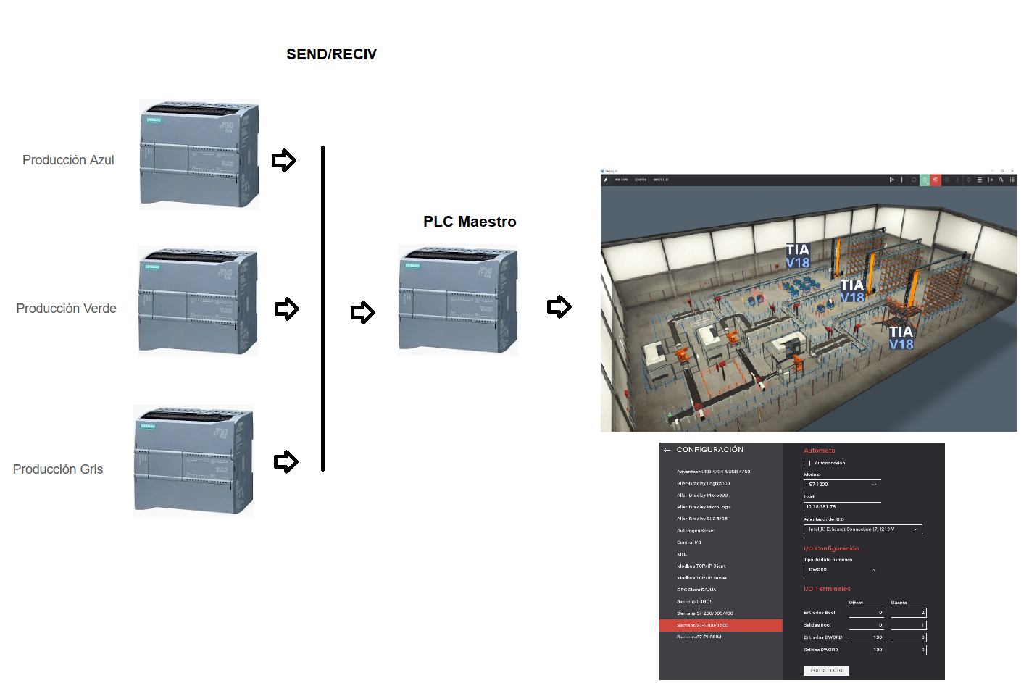
5. PLC Sare birtuala (3 Tia Portal+PLCSIM+NetTOPLC + 3 Codesys > Keepserver > Factory)
OPC Server/Client
Beste aukera bat: PLC Maestro
*Aldagaiak sinkronizatu behar dira baita

Slide 30
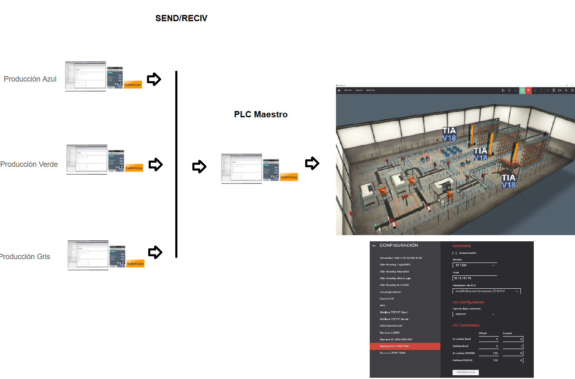
5. PLC Sare birtuala (3 Tia Portal+PLCSIM+NetTOPLC + 3 Codesys > Keepserver > Factory)
OPC Server/Client
Beste aukera bat: PLC Maestro
*Aldagaiak sinkronizatu behar dira baita

